Slide 1

GLA University Mathura FullStack Project Session – 2021-22
Floracity

Slide 2
Developers
Tanya Agrawal (191500849)
Sakshi Garg (191500699)
Vartika Saxena (191500896)

Slide 3
Technologies Used
HTML
CSS
JAVASCRIPT
BOOTSTRAP

Slide 4
INTRODUCTION
E-commerce is fast gaining ground as an accepted and used business paradigm. More and more business houses are implementing web sites providing functionality for performing commercial transactions over the web. It is reasonable to say that the process of shopping on the web is becoming commonplace.
FloraCity is basically an E-Commerce store where user can search about any type of flora specie and can purchase it at reasonable rates.

Slide 5
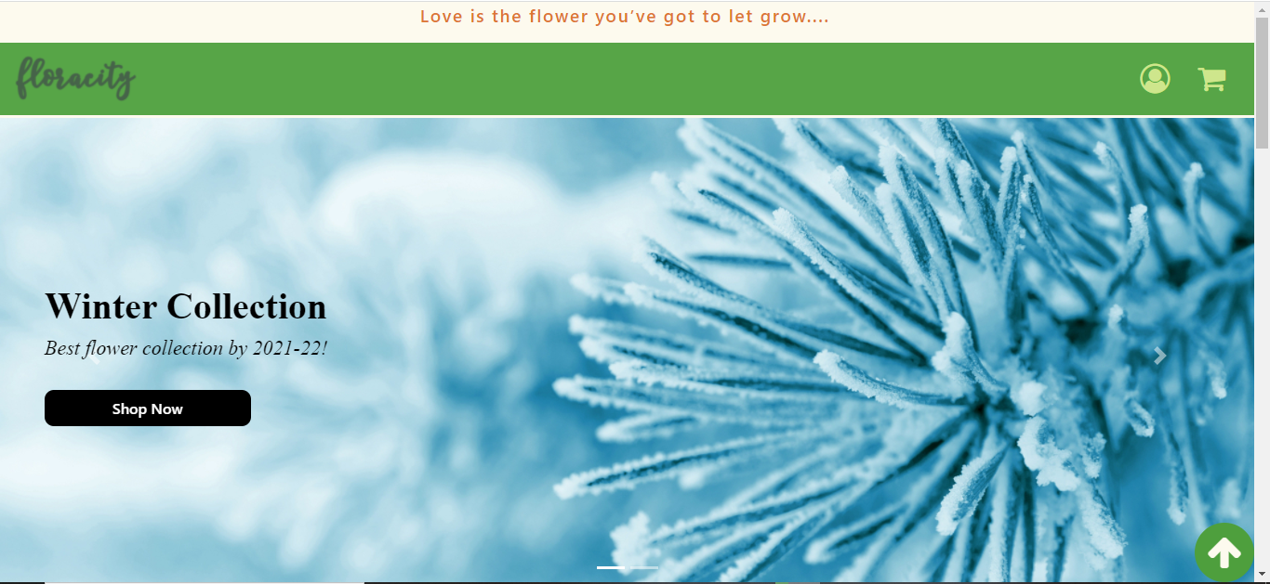
Few Glimpse

Slide 6
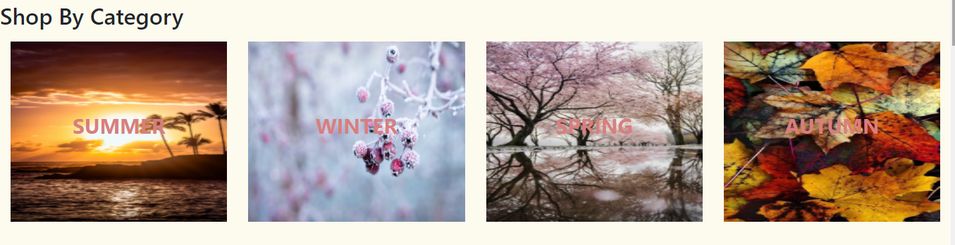
Categories Available

Slide 7
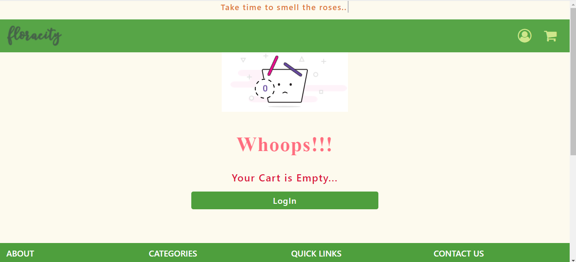
Empty Cart

Slide 8
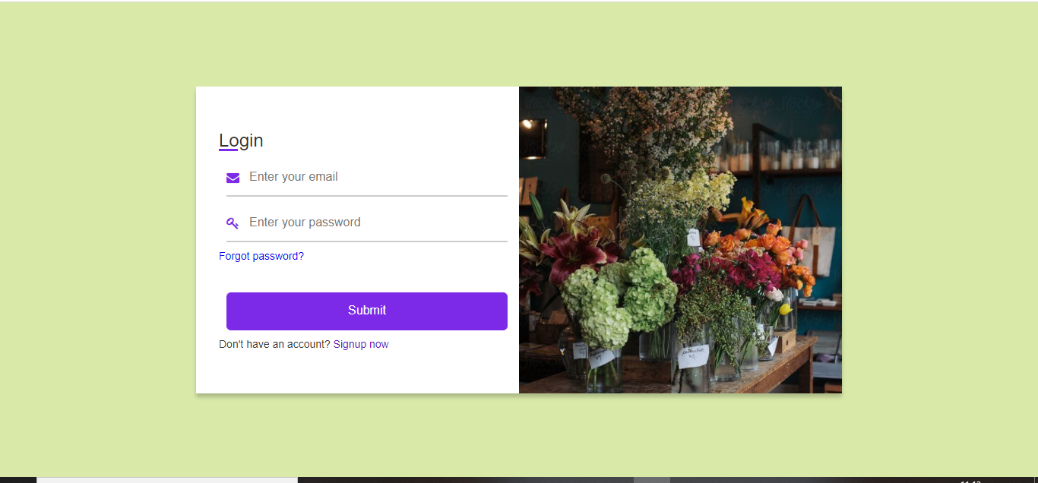
User LogIn

Slide 9
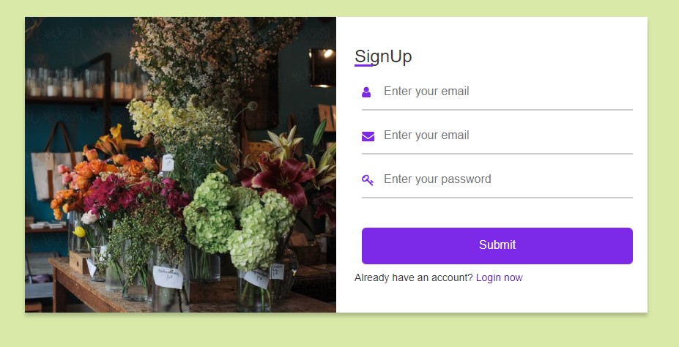
User Register

Slide 10
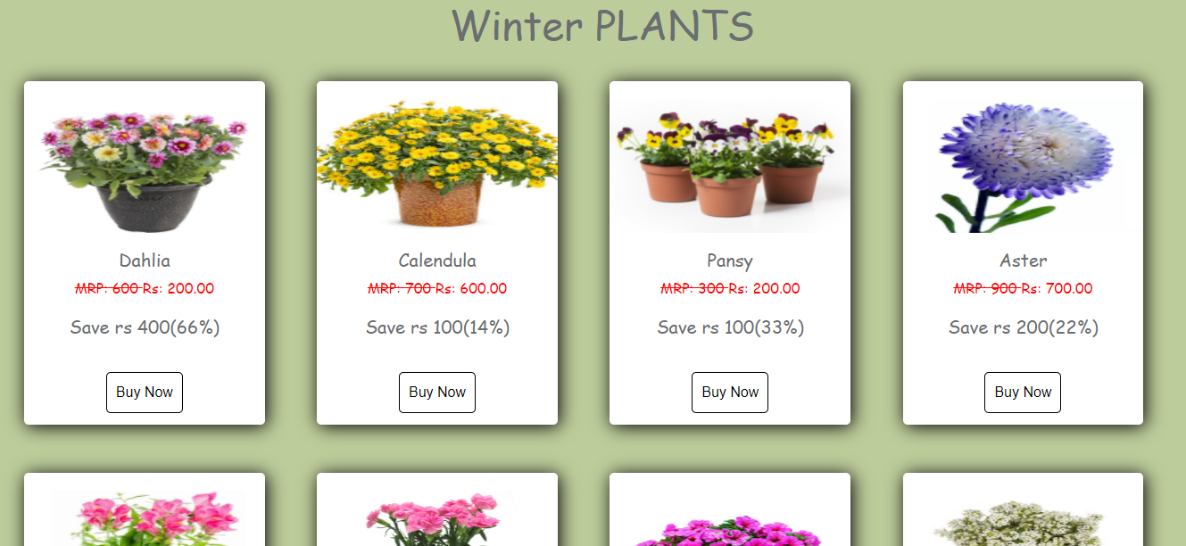
Items per category

Slide 11
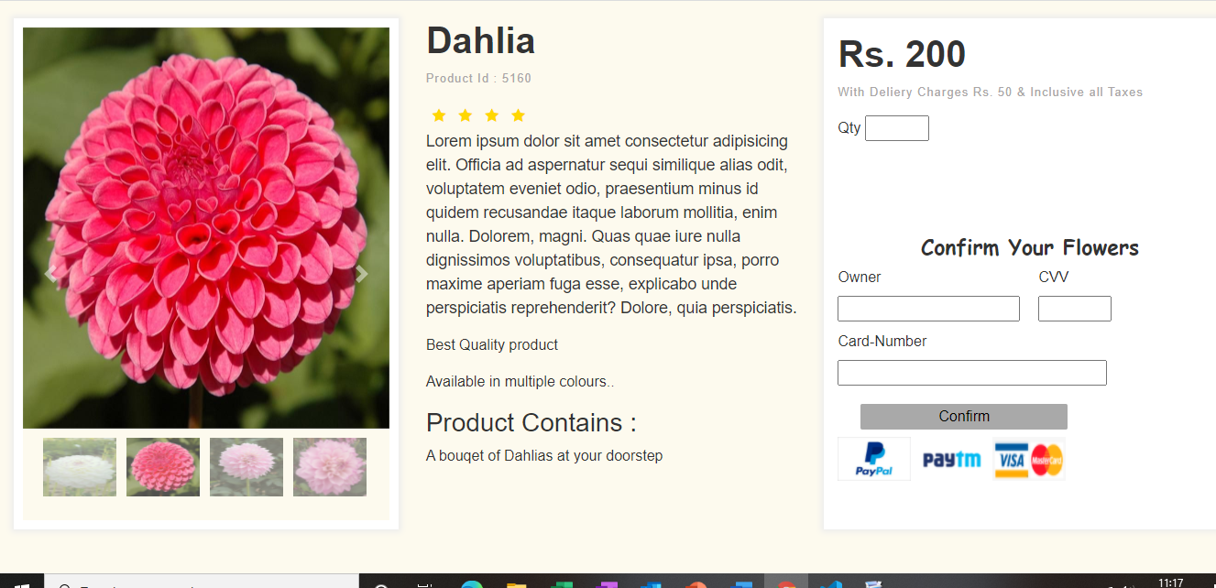
Product Page

Slide 12
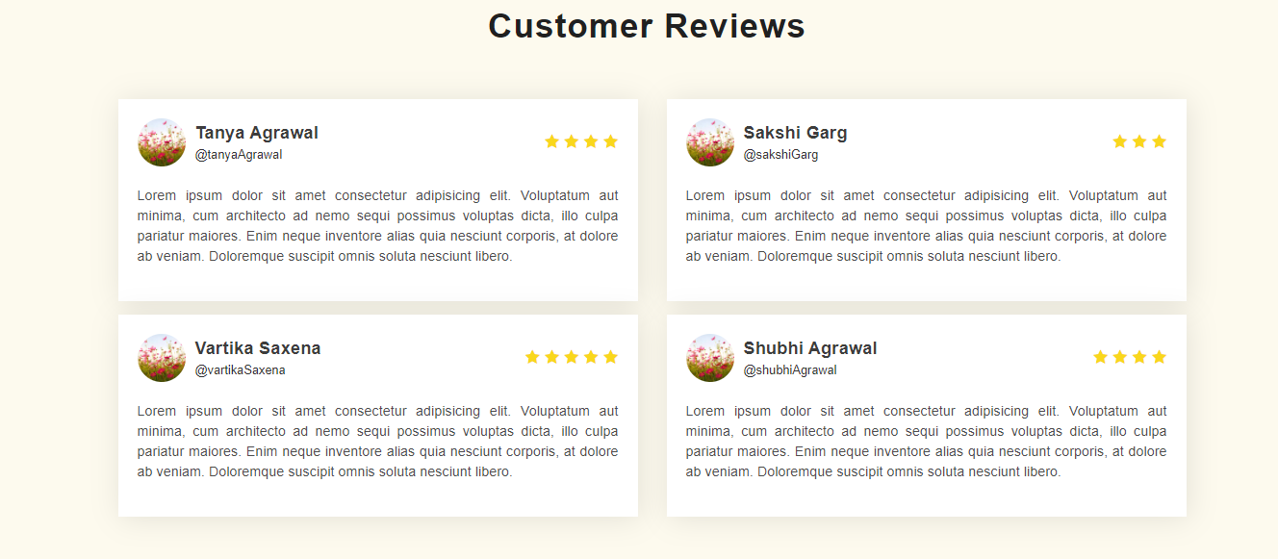
Customer Reviews

Slide 13
Git Repository
https://github.com/TanyaMittal31/FloraCity
https://tanyamittal31.github.io/FloraCity/

Slide 14
Conclusion
Focusing on the current requirements of a healthy life and to make the life easier of our customers we are going to work on this great and handy ecommerce store.

Slide 15
References
www.beta-labs.in
https://www.w3schools.com
https://stackoverflow.com
Wikipedia
https://github.com/
https://www.ugaoo.com/?gclid=CjwKCAjwhaaKBhBcEiwA8acsHH_Ira3L5iI03G3EmEVyJernK2423e_USr5rj-mCT1Hqtg08hx0ZRhoC_3YQAvD_BwE
Naturelive
YouTube

